Slide 1
Industry 4.0 in EU Framework Programmes
Martin Huemer
Directorate Prosperity – Unit Industry 5.0
DG Research & Innovation
European Commission

Slide 2
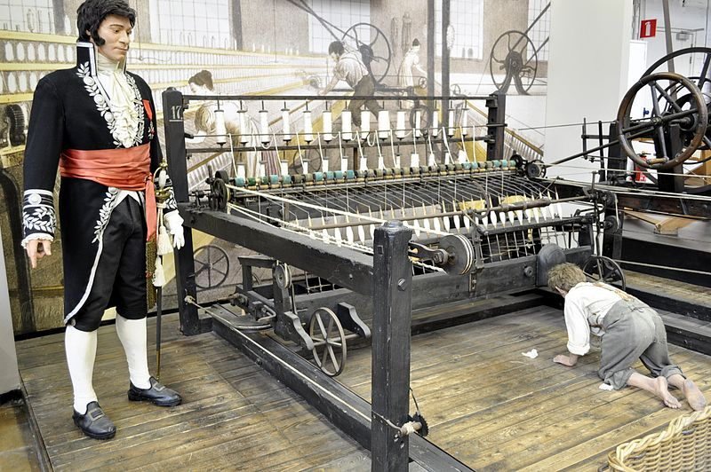
19th Century – the First Industrial Revolution

Slide 3

21st Century – the Fourth / Fifth Industrial Revolutions

Slide 4
Fourth Industrial Revolution
Overcomes borders between physical, digital and biological worlds
Exponential pace
Disruptive for industry
Impacts on life and society
Klaus Schwab: We live in a time of great promise and great peril

Slide 5
Fourth Industrial Revolution – the Potential and the Risks
Access to vast range of knowledge and services
Flexible Production
Localised, sustainable production
Opportunities for better jobs
Adapting to the rapid transformation
Impact on jobs and people
Can new jobs compensate for loss of old jobs?
Ethics, taxation, …

Slide 6
Fourth Industrial Revolution – the EU Approach
Strengthen technology base and innovation capacity of industry
Industry provides 20% of jobs, generates 80% of exports and is the primary source of private R&D
Digitising European Industry Initiative, April 2016
Digital Innovation Hubs, updating digital regulatory framework
Horizon 2020 (KETs, NMBP programme, cPPPs)
Horizon Europe (EIC, European Partnerships, 15 bn for cluster « digital, industry and space »)

Slide 7
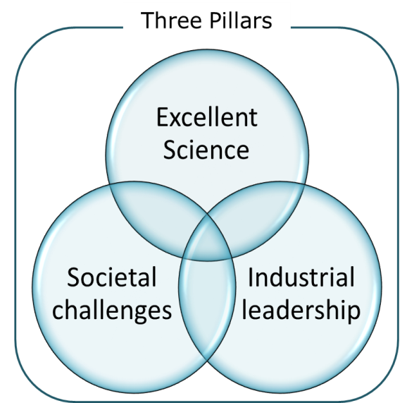

KETs - NMBP in Horizon 2020
Industrial
Leadership
Leadership in enabling and industrial technologies
Leadership in
enabling and industrial
technologies
ICT
NMBP
SPACE
Access to Risk
Finance
Innovation to SME
Indicative Budget:
16.5 billion €
Out of it for NMBP:
3.8 billion €
Nano- and Micro- electronics
Photonics
Nanotechnologies
Advanced Materials
Biotechnology
Advanced Manufacturing & Processing
Indicative budget:
75 billion € *

Slide 8
LEIT - NMBP part of Horizon 2020
Emphasis on:
R&D and innovation with a strong industrial dimension and in partnership with industry;
Activities primarily developed through relevant industrial roadmaps (ETPs, PPPs)
Requirements for business cases and exploitation strategies for industrialisation
Strengthening industrial capacities including SMEs, including through synergies with other funds (private – public);
Cross-cutting KETs, including pilot lines and demonstrators, addressing societal challenges
Outcome and impact orientation, developing key technology building blocks and bringing them closer to the market:
Technology Readiness Level (TRLs) from 3-4 to 6-7 with emphasis on expected impact;
Total budget under Horizon 2020: 3.8 billion €

Slide 9
Public Private Partnerships (PPPs)
Industry plays a leading role in defining research priorities
Pre-defined budget ensures continuity and commitment
Focused on enabling industrial technologies
Increased use of SME-friendly instruments and demonstration
Roadmaps prepared with large stakeholder involvement and public consultation
Concrete technological and sector related objectives – commitment from industry to reach them and to provide the necessary R&D+I investments
Using fully open H2020 calls
Industry commitment for leverage and further investments

Slide 10
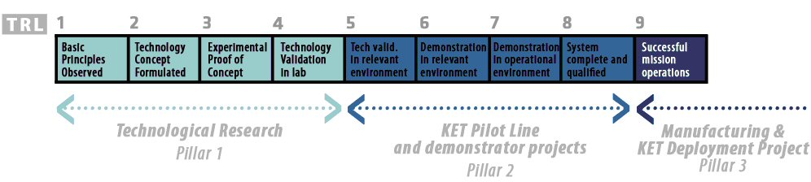
Technology Readiness Levels (TRLs)
The LEIT part of Horizon 2020 targets TRLs from 3-4 up to 7 with a centre of gravity on 5-6
Highest TRLs for cases with a strong industrial commitment
Beyond TRL 7: explore paths to commercial exploitation, to deploy technologies funded under Horizon 2020

Slide 11
Based on the Commission Proposal for Horizon Europe, the common understanding between co-legislators and the Partial General Approach, both approved in April 2019

Slide 12



Horizon Europe: Preliminary structure
Pillar 1
Excellent Science
Pillar 2
Global Challenges and European Industrial Competitiveness
Pillar 3
Innovative Europe
European Research Council
Health
Culture, Creativity and Inclusive Society
Civil Security for Society
Digital, Industry and Space
Climate, Energy and Mobility
Food, Bioeconomy, Natural Resources, Agriculture and Environment
European Innovation Council
Marie Skłodowska-Curie Actions
Clusters
European innovation
ecosystems
European Institute of Innovation and Technology
Research Infrastructures
Joint Research Centre
Widening Participation and Strengthening the European Research Area
Widening participation and spreading excellence
Reforming and Enhancing the European R&I system

Slide 13

European Innovation Council
Support to innovations with breakthrough and disruptive nature and scale up potential that are too risky for private investors (70% of the budget earmarked for SMEs)
Helping innovators create markets of the future, leverage private finance, scale up their companies,
European Innovation Council – a one-stop-shop
Innovation centric, risk taking & agile, pro-active management and follow up
Two complementary instruments bridging the gap from idea to investable project
Pathfinder: grants
(from early technology to pre- commercial)
Accelerator: grants only & blended finance
(from pre-commercial to market & scale-up)

Slide 14
New approach to European Partnerships
New generation of objective-driven and more ambitious partnerships in support of agreed EU policy objectives
Key features
Simple architecture and toolbox
Coherent life-cycle approach
Strategic orientation
Co-programmed
Based on Memoranda of Understanding / contractual arrangements; implemented independently by the partners and by Horizon Europe
Co-funded
Based on a joint programme agreed and implemented by partners; commitment of partners for financial and in-kind contributions
Institutionalised
Based on long-term dimension and need for high integration; partnerships based on Articles 185 / 187 of TFEU and the EIT-Regulation supported by Horizon Europe

Slide 15
Cluster 4 Digital, Industry and Space: Priorities
Reshaping economies and societies through key enabling technologies (KETs) and digital transformation
for autonomy and leadership; and
for addressing global challenges
Industry producing in Europe / Human centred ecosystem
Industry reducing green-house gas emissions
Industrially-oriented infrastructures (KETs / digital)
Use of enabling, digital and space technologies
Generation and valorisation of big data
“… by design” / Life Cycle Analysis

Slide 16

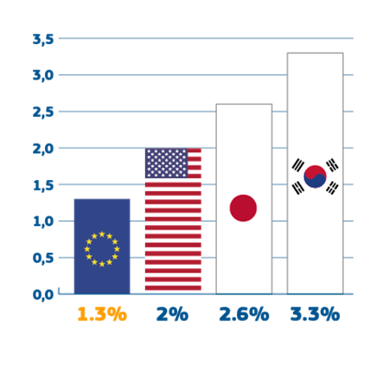


Challenges addressed by Cluster 4
EU industry faces global competition and its autonomy is compromised
business R&D lower in EU than US, S Korea, Japan
R&D share in high-tech sectors lower in EU
Planetary boundaries require a fundamental transformation
to cope with scarce resources, incl. energy
to reduce greenhouse gas emissions
Growing social inequalities
disparities in investments, technological specialisation
impact of digitisation / artificial intelligence / future of work
concerns about new technologies
Notes:
Horizon Europe will continue to support the Key Enabling Technologies:
life sciences
advanced manufacturing technologies
advanced materials and nanotechnologies
micro-/nano-electronics and photonics
artificial intelligence
security and connectivity.
KETs are paramount in taking excellent science to the market, and to ensure the success of innovations made in Europe. The KETs will be crucial to increase the impact of the European Innovation Council, and will enable the achievement of the goals for Global Challenges.

Slide 17
Cluster 4 Digital, Industry and Space: what's new?
This cluster will support European industrial leadership and autonomy, while respecting planetary boundaries.
Emphasis on European social and ethical values, e.g. the human element in manufacturing, the skills needed, trustworthy AI and citizens, protecting privacy.
Raw materials: after creating a research community in H2020, more emphasis on piloting, large scale demonstrators and finding alternatives for critical raw materials
Space: R&I actions will be streamlined to support the proposed single Space Programme in the MMF, which gathers under one umbrella earth observation, geolocalisation, space surveillance and tracking, and secure communication.

Slide 18
Cluster 4 Digital, Industry and Space: what?
10 intervention areas:
Manufacturing technologies
Key digital technologies
Emerging Enabling Technologies
Advanced materials
Artificial intelligence and robotics
Next generation internet
Advanced computing and big data
Circular industries
Low carbon and clean industries
Space
Notes:
Manufacturing technologies, example: new additive manufacturing technologies, skills adapted to the new technologies
Key digital technologies, example: nano-electronics and photonics, enabling applications in many fields
Emerging technologies example: information-based technologies inspired by the laws of nature and biology
Advanced materials, example: materials designed with new properties, e.g. for batteries and bio-plastics
Artificial intelligence and robotics, example: AI to improve our health care, manufacturing, construction, reducing fatality rates in traffic accidents, fighting climate change, anticipating cybersecurity threats, while respecting data privacy
Next generation internet, example: Applications and services for consumers, industry and society, 5G technologies and beyond
Advanced computing and big data, example: Exascale computing (a billion billion calculations per second), privacy by design in using personal big data
Circular industries, example: maintaining EU resources, materials and products for longer term, creating new value chains
Low carbon and clean industries: example: breakthrough technologies for energy-intensive industries will lead to significant greenhouse gas reductions
Space, example: end-to-end satellite communications for citizens and businesses, to connect people, to develop 5G-enabled connectivity for the Internet of Things and the Next Generation Internet

Slide 19
Cluster 4 Digital, Industry and Space: how will it link to other EU programmes?
The Digital Europe Programme (DEP) will use public procurement to deploy the digital technologies and infrastructures (in particular in artificial intelligence, cybersecurity and high-performance computing)
The European Space programme will feed R&I priorities into this cluster, will pick up results for applications in e.g. agriculture, climate monitoring
The InvestEU Fund can finance innovators and innovations coming from this cluster, to enable their roll-out and scale-up
The European Regional Development Fund (ERDF) may support the take-up of results emerging from this cluster
The Connecting Europe Facility (CEF) supports the large-scale roll-out and deployment of innovative new technologies and solutions in transport, energy and digital-physical infrastructures
The Single Market Programme will support the competitiveness of SMEs and entrepreneurship (e.g. Enterprise Europe Network)

Slide 20
Cluster 4 Digital and Industry: intervention areas in keywords
Manufacturing technologies, broad lines:
additive manufacturing, robotics
different enabling technologies across value chain
skills
flexible zero-defect and zero-waste plants
construction, pre-fabricated components
Notes:
Manufacturing technologies, example: new additive manufacturing technologies, skills adapted to the new technologies

Slide 21
Cluster 4 Digital and Industry: intervention areas in keywords
Key digital technologies, broad lines:
nano-electronics
sensing technologies, part of the Internet of Things
alternative technologies such as neuromorphic computing or quantum computing
computing architectures and low-power processors for a wide range of applications
computing hardware designs, security-protection
photonics
system engineering technologies for autonomous systems
software technologies
emerging technologies
Notes:
Key digital technologies, example: nano-electronics and photonics, enabling applications in many fields

Slide 22
Cluster 4 Digital and Industry: intervention areas in keywords
Emerging Enabling Technologies, broad lines:
future and emerging trends in key enabling technologies
support for emerging communities incl. human centred-approach
broaden the industrial basis for adopting disruptive technologies
Notes:
Advanced materials, example: materials designed with new properties, e.g. for batteries and bio-plastics

Slide 23
Cluster 4 Digital and Industry: intervention areas in keywords
Advanced materials, broad lines:
materials with new properties
integrated materials processes and production
enablers like characterisation, modelling
infrastructures for uptake by SMEs of key technologies
analysis of trends in advanced materials
solutions for users, also for creative industries
Notes:
Advanced materials, example: materials designed with new properties, e.g. for batteries and bio-plastics

Slide 24
Cluster 4 Digital and Industry: intervention areas in keywords
Artificial Intelligence and Robotics, broad lines:
enabling AI technologies such as machine learning
robotics
user-driven AI technologies
research competences for AI
technologies for open AI platforms like algorithms
Notes:
Artificial intelligence and robotics, example: AI to improve our health care, manufacturing, construction, reducing fatality rates in traffic accidents, fighting climate change, anticipating cybersecurity threats, while respecting data privacy

Slide 25
Cluster 4 Digital and Industry: intervention areas in keywords
Next generation internet, broad lines:
network and service infrastructures, enabling e.g. IoT, blockchain
next generation internet applications
middleware incl. distributed ledger technologies, embedding AI
Notes:
Next generation internet, example: Applications and services for consumers, industry and society, 5G technologies and beyond

Slide 26
Cluster 4 Digital and Industry: intervention areas in keywords
Advanced computing and big data, broad lines:
high performance computing
big data
reduced carbon footprint of ICT
Notes:
Advanced computing and big data, example: Exascale computing (a billion billion calculations per second), privacy by design in using personal big data

Slide 27
Cluster 4 Digital and Industry: intervention areas in keywords
Circular industries, broad lines:
industrial symbiosis
life-cycle assessment of materials
products for enhanced life-cycle performance
recycling industry
elimination of substances of concern
sustainable supply of raw materials
Notes:
Circular industries, example: maintaining EU resources, materials and products for longer term, creating new value chains

Slide 28
Cluster 4 Digital and Industry: intervention areas in keywords
Low-carbon and clean industries, broad lines:
process technologies without greenhouse gasses
industrial CO2 valorisation
electrification within industrial plants
industrial products with low or zero carbon emissions
Notes:
Low carbon and clean industries: example: breakthrough technologies for energy-intensive industries will lead to significant greenhouse gas reductions

Slide 29
Cluster 4 Digital and Industry: intervention areas in keywords
Space, broad lines:
Galileo and EGNOS (positioning)
Copernicus (earth observation)
Space situational awareness
Secure satellite communications for EU governments
Space Technologies supporting EU global competitiveness
Independence for critical components
Space science and exploration
Notes:
Space, examples: prepare the next generation of technologies and services for Galileo and Copernicus, develop tools to monitor and forecast space weather, space debris, demonstrate the potential for highly secured communications between EU governments, pursue technological development enabling our independent access to space and enable the full space communication potential implementing for example 5G connectivity, internet of things.

Slide 30
Widening Participation and Strengthening the European Research Area:
Widening Participation and Spreading Excellence, e.g.
Teaming & twinning
ERA Chairs
COST
Support to NCPs
Brain circulation and excellence initiatives
“Hop-on“
Reforming and enhancing the European R&I system
Scientific evidence & foresight
Open Science
Policy Support Facility
Attractive researcher careers
Citizen science, Responsible Research & Innovation
Gender equality
Common understanding: At least 3.3 % of Horizon Europe budget

Slide 31
Have your say on Horizon Europe!
Public consultation on future objectives for EU-funded research and innovation (open till 4 October 2019)
https://ec.europa.eu/eusurvey/runner/HorizonEurope_Codesign_2021-2024

Slide 32
Further information Horizon 2020
Horizon 2020: http://ec.europa.eu/research/horizon2020/index_en.cfm
Key Enabling Technologies, R&I website : http://ec.europa.eu/research/industrial_technologies/index_en.cfm
Participant Portal - Funding Opportunities and support services
http://ec.europa.eu/research/participants/portal/desktop/en/home.html
NMBP Work Programme :
http://ec.europa.eu/research/participants/data/ref/h2020/wp/2016_2017/main/h2020-wp1617-leit-nmp_en.pdf
http://ec.europa.eu/research/participants/data/ref/h2020/wp/2016_2017/main/h2020-wp1617-focus_en.pdf (cross-cutting - focus areas)
National Contact Points in your country (NMP) http://ec.europa.eu/research/participants/portal/desktop/en/support/national_contact_points.html#c,contact=country/sbg//1/1/0&+person.last_name/desc
National Contact Points website - webinars, presentations, guidance : http://www.nmpteam.eu/
Research Enquiry Service: http://ec.europa.eu/research/index.cfm?pg=enquiries
CORDIS database with EU funded research projects : http://cordis.europa.eu/projects/home_en.html

Slide 33

Horizon Europe - keep up to date via:
#HorizonEU
@Moedas @EUScienceInnov @EU_H2020 @HorizonMagEU
https://www.facebook.com/EUScienceInnov/
https://www.facebook.com/cmoedas/
Horizon Europe dedicated website http://ec.europa.eu/horizon-europe
European Innovation Council http://ec.europa.eu/research/eic
EU budget for the future http://ec.europa.eu/budget/mff/index_en.cfm

