Slide 1




Companies of the future and Regional innovation ecosystem
ОБЩИНА ГАБРОВО
Nikolinka Hinkova, dipl.eng.
Member of the BoD of Mechatronica JSC
Gabrovo, Sept 17th 2019

Slide 2

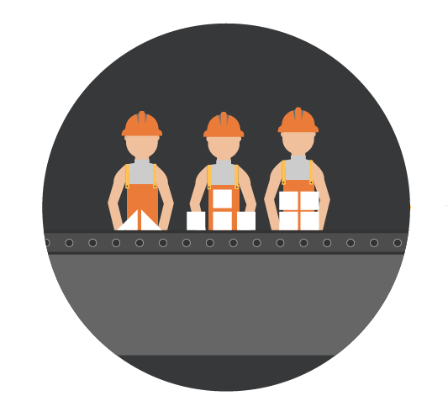
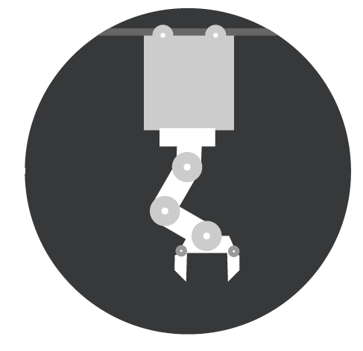


Ready for Industry 4.0 !!!???
- 2 -
LINEAR ECONOMY
take – make – use - dispose
1765 1870 1969
DIGITALISATION (Industry 4.0) and CIRCULAR ECONOMY (the driver of innovation)
repair
nowadays
recycle
reuse

Slide 3

Center
Companies of the future
- 3 -
Да превърнем науката в нови материали, технологии и продукти
The essential success factor is
COLLABORATION
University / R&D institute
Regional
Innovation
companies
Local / regional government
Supporting the high added value economy

Slide 4






COMPANIES OF THE FUTURE
- 4 -
Managing the innovation through Regional innovation ecosystem
COMPANIES
R & D institute/UNIVERSITY
REGIONAL government
Institute of Solid State Physics
ОБЩИНА ГАБРОВО

Slide 5
- 5 -
4 directions:
Incubator for talents
Devices for automation
Materials and technologies
Circular economy

Slide 6
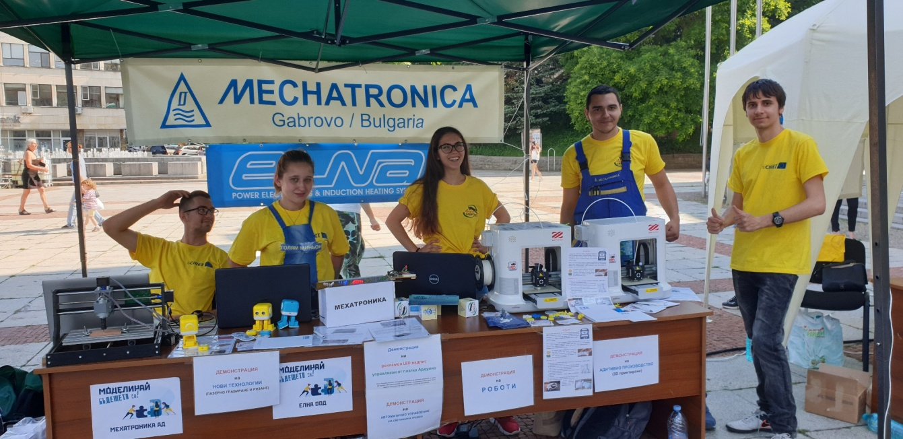
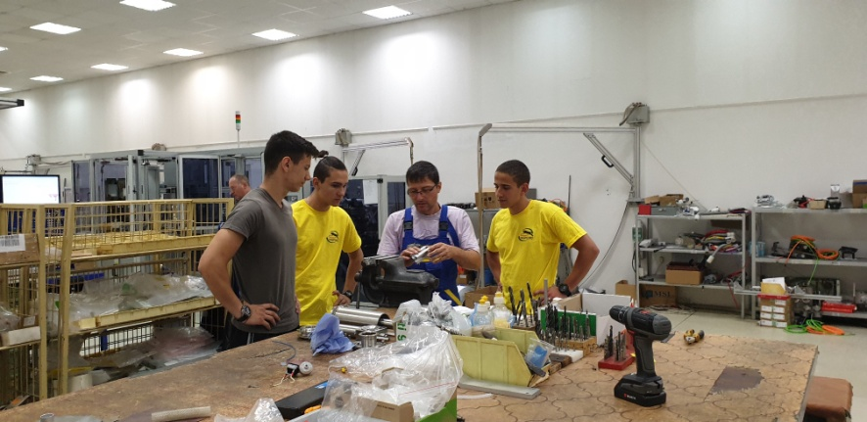
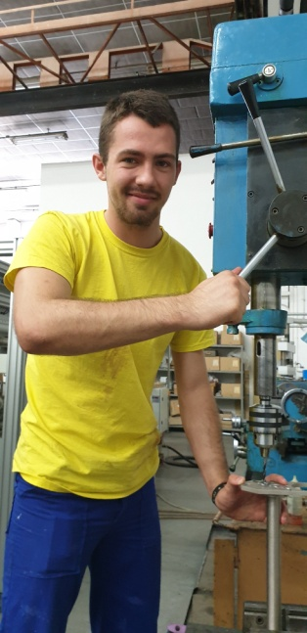
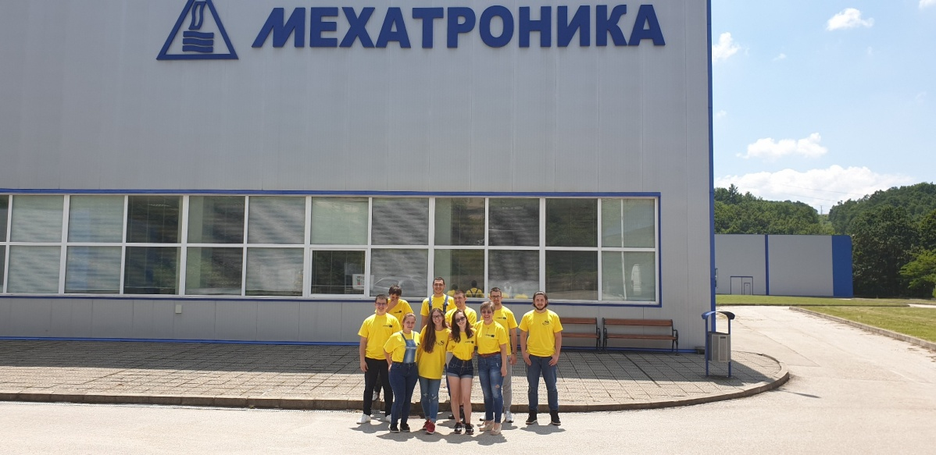
Incubator for talents
- 6 -
Widening of digital skills (ICT standardization)
Work based learning (legislation, too many regulation)

Slide 7
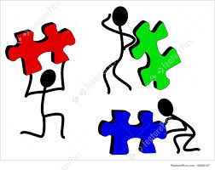

Devices for automation
- 7 -
Innovative partners in design and manufacture of servo drives, linear motors, etc.
Characteristic: modular principle
Let’s together construct the puzzle and get a clearer picture

Slide 8
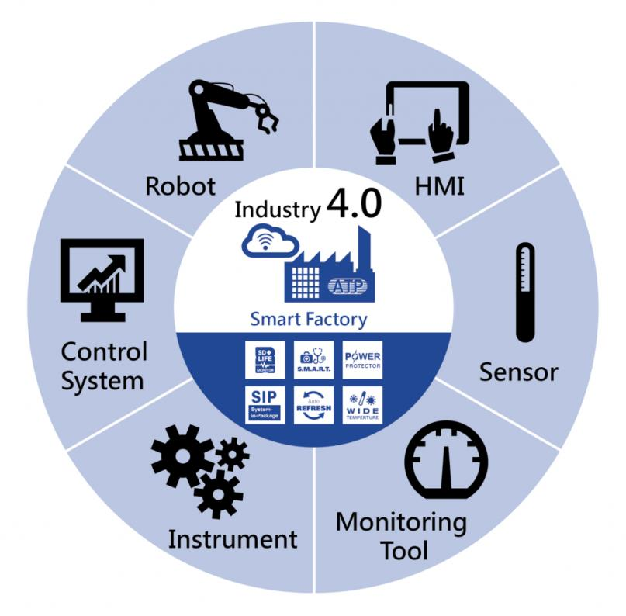
- 8 -
Materials and Technologies
Fast and save technologies with digital twins

Slide 9
Circular economy
- 9 -
Clean and safe energy
Resources and materials’ efficiency
Making the most of resources:
repair - reuse - recycle
EU manufactures > 2.5 billion tons of wastage
Global economy – only 9% circular

Slide 10
The challenge is our opportunity
- 10 -
The digital region of Gabrovo
ready for Industry 5.0 – the human factor and the AI
The human creativity will always be a factor, but we have to change ourselves together with all the innovations

Slide 11
Join us in our innovation efforts
Thanks!

